Slide 1
S&B Landscaping Website COSC412 Individual Project
By: Brandon Bankston

Slide 2
Project Overview
Website was designed and created to be able to receive client's information through contact us forms, and to be able to record and show reviews.
To demonstrate gallery photos of previous work.
Hosted on Stellar Shared Linux.

Slide 3
Tools Used
Github desktop and Git
WordPress
Namecheap
Elementor
PayPal

Slide 4
Roles
Lead Developer: Brandon
Tester: Brandon
Administrator: Brandon

Slide 5
Security
reCAPTCHA enabled on fill in forms
Domain name and privacy protection
SSL enabled
Daily backups

Slide 6
Functional Requirements
Contact us page
Security check/reCAPTCHA (used v3, so it is automatic but sometimes fails and user must resubmit form)
Payment Page
Testimonial Page

Slide 7
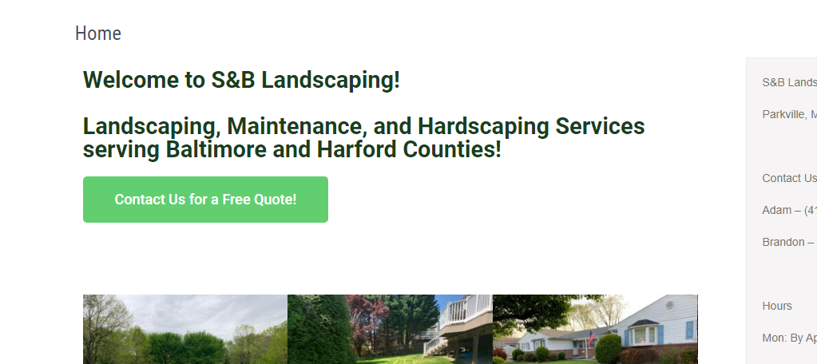
Home Page
Users can use website menu functionally and can go page to page.
Brief overview of what the company has to offer.
https://sblandscaping.biz/

Slide 8
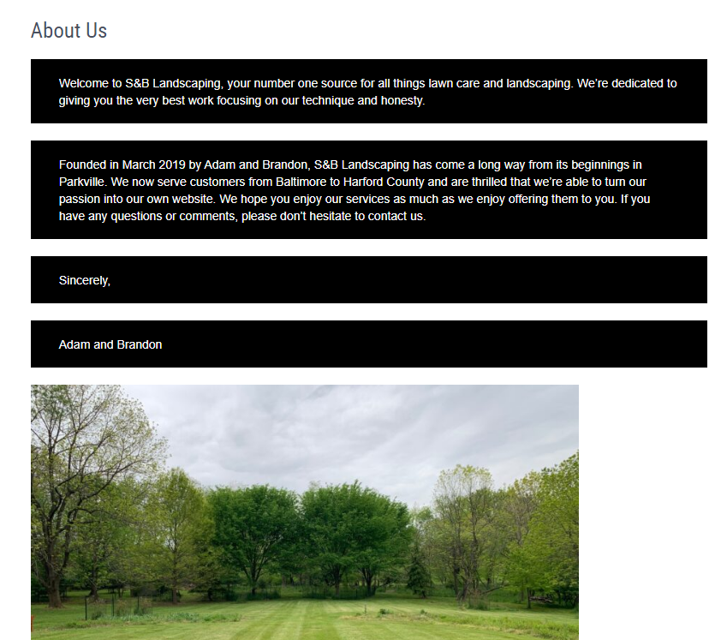
About us
Users can view a little bit about the owners and that page is functioning.
https://sblandscaping.biz/aboutus/

Slide 9
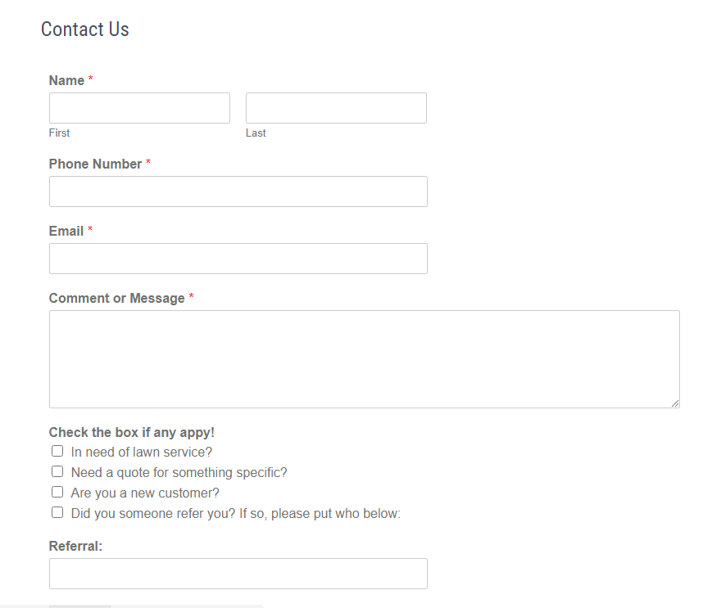
Contact Us
Users can fill out the contact us information page to request services.
User can select specific options if they apply to them.
https://sblandscaping.biz/contactus/

Slide 10
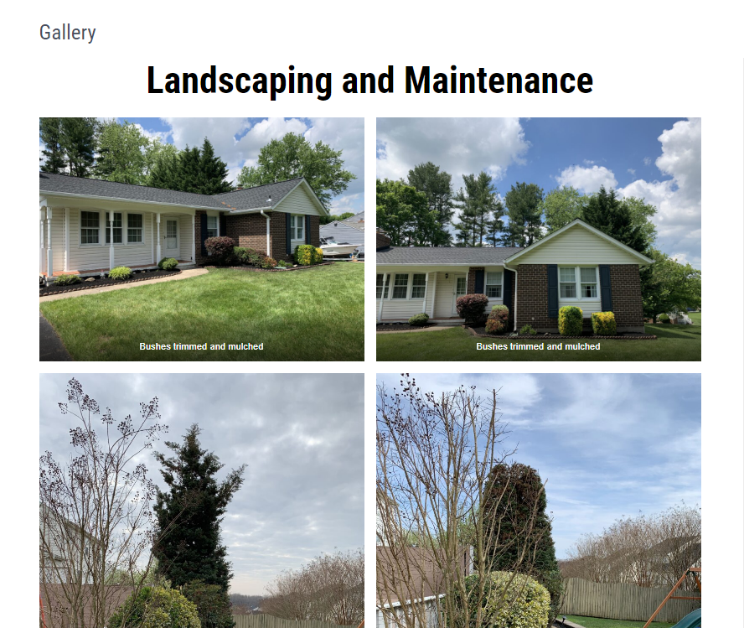
Gallery
Users can view photos of previous jobs before and after photos.
https://sblandscaping.biz/gallery/

Slide 11
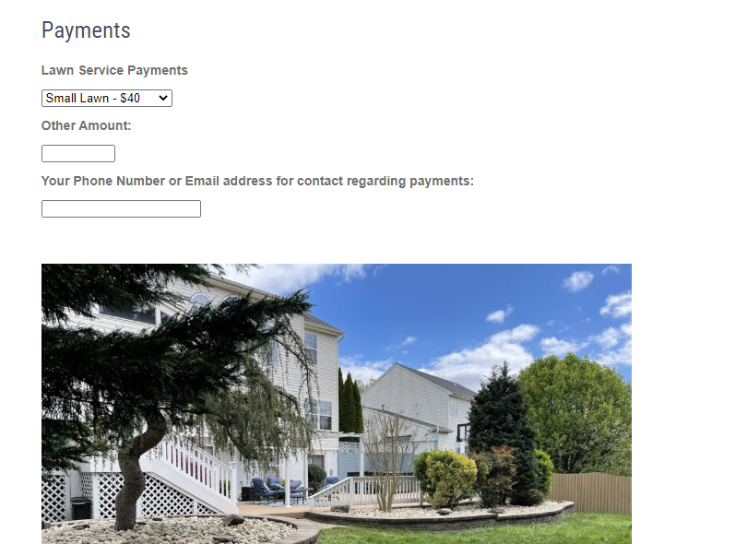
Payments
Users can pay for lawn service or other services.
Users can add in contact info to go along with their payments.
https://sblandscaping.biz/payments/

Slide 12
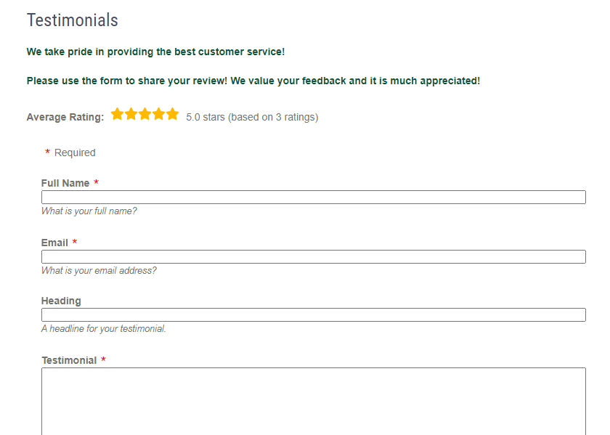
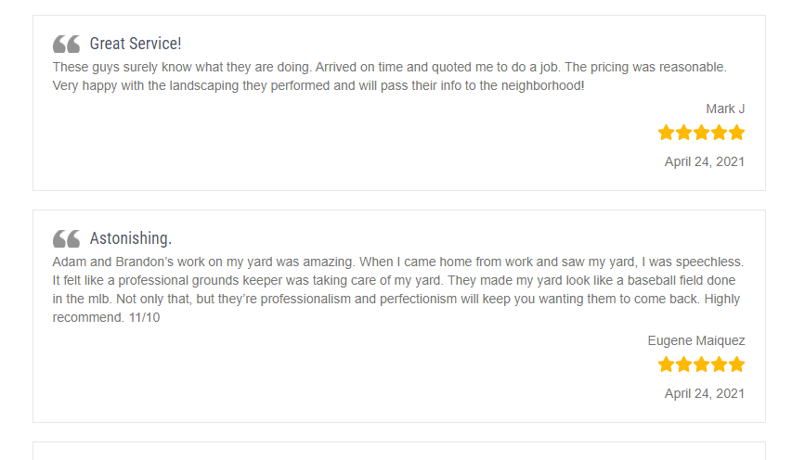
Testimonials
Users can fill out a testimonial form.
Users can read previous testimonials.
https://sblandscaping.biz/testimonials/

Slide 13
The End
Thank you!

